Slide 1
Uninformed/Informed Search (Chapter 3)
Dr. Shengquan Wang
Most slides are adopted from
Artificial Intelligence: A Modern Approach, 4th ed. by Stuart Russell (UC Berkeley) and Peter Norvig (Google).
Peter Norvig and Sebastian Thrun for Intro to Artificial Intelligence at Udacity.
Dan Klein and Pieter Abbeel for CS188 Intro to AI at UC Berkeley.

Slide 2
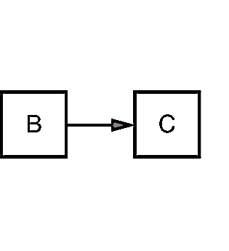
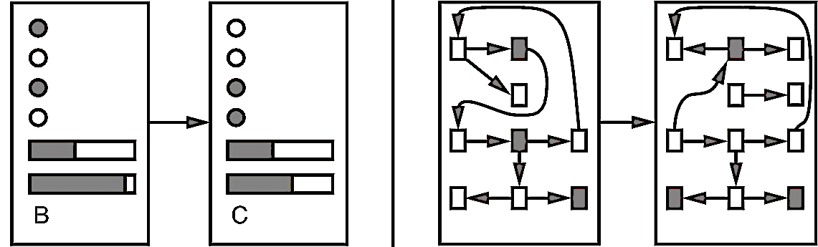
Goal-based Agents
Goal-based agents
Problem-solving agents
Planning agents
Problem-solving agents use atomic representations.
It can be solved by general-purpose search algorithms.
Planning agents use more advanced factored or structured representations for situation such as uncertainty.
Notes:
*problem-solving agents can especially solve redundant/repetitive tasks, or solve a problem in a very discrete environment.

Slide 3
Outline
Problem-Solving Agents

Slide 4
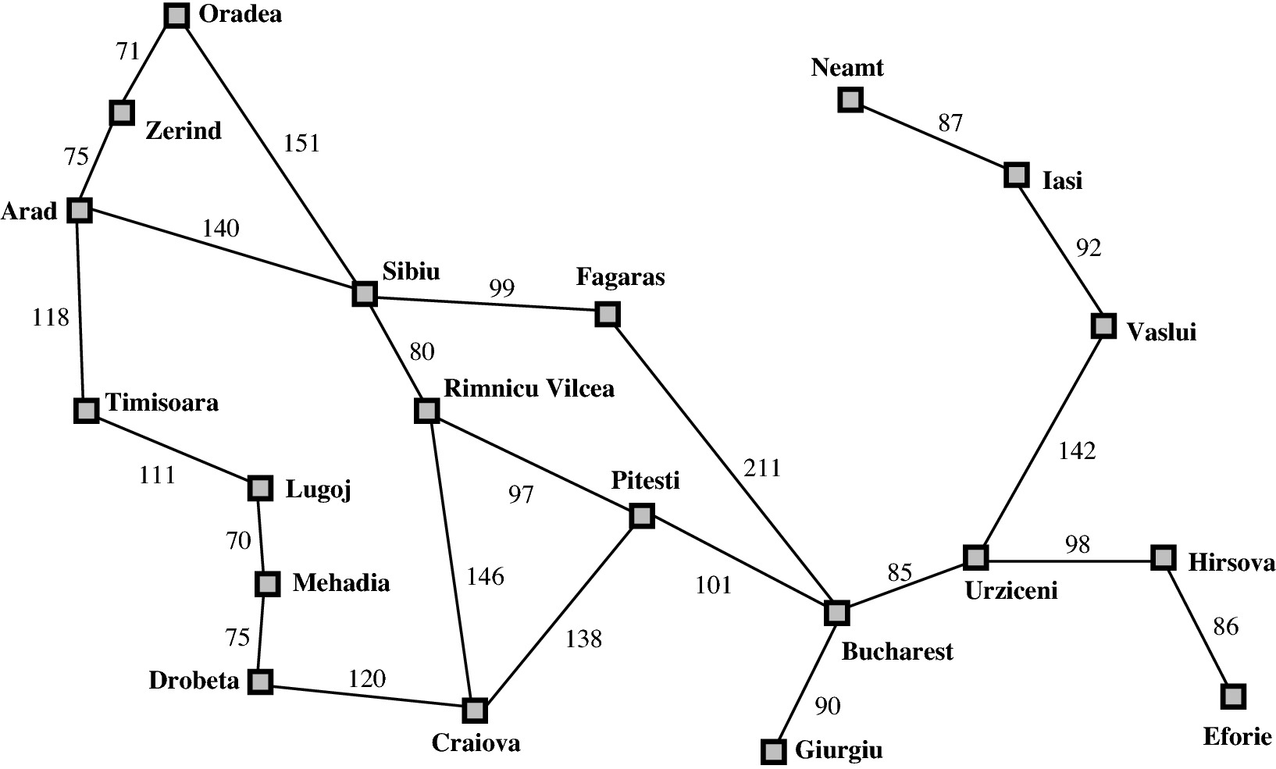
Example: Traveling in Romania
Notes:
*note: The first letter of all cities combine to give the alphabet set (a, b, c, d….z).

Slide 5
Problem-Solving Agents
A problem can be defined by:
State space
Possible states including initial state and goal state
Possible actions
Transition model (what each action does)
Goal test:
To determine if a given state is a goal state
Path cost:
Summation of step cost
Notes:
*

Slide 6
Example: Traveling in Romania
States | Cities
Actions | Drive between cities
Goal test | ?= Bucharest
Path costs | Link costs

Slide 7
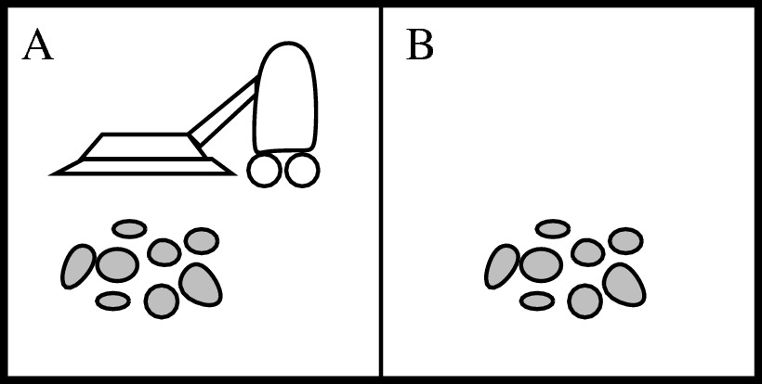
Example: Vacuum World
States | Dirt and robot locations
Actions | Left, Right, Suck, NoOp
Goal test | No dirt
Path costs | 1 per action (0 for NoOp)
Notes:
Text: P.36
*8 total possible states – 2^3: dirty or not (binary) → 2 * 2 locations that could be dirty or not * 2 possible locations where the robot could be.

Slide 8
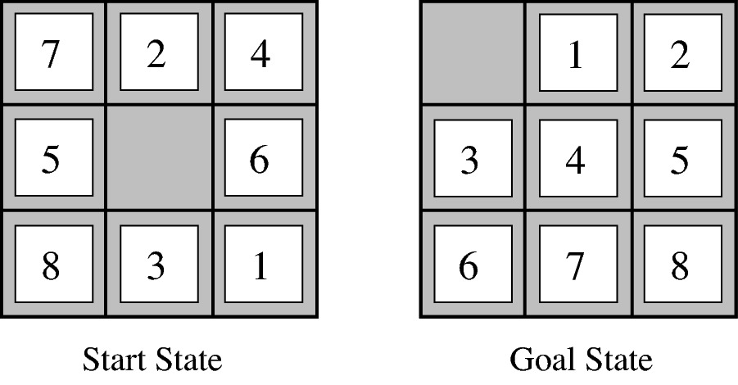
Example: 8-Puzzle
States | Locations of tiles
Actions | Move blank left, right, up, down
Goal test | Given
Path costs | 1 per move
Notes:
Total number of possible states = 9! (“nine factorial”).

Slide 9
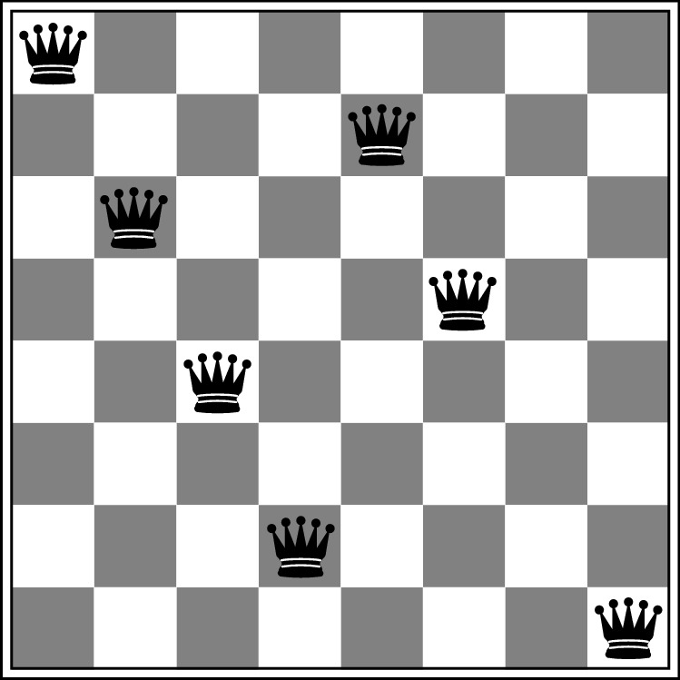
Example: 8-Queen
States | Any arrangement of 0 to 8 queens on the board
Actions | Add a queen to any empty square
Goal test | 8 queens are on the board, none attacked
Path costs | N/A
Notes:
Total number of possible states: SUM_i=0_i=8(64, choose i)

Slide 10
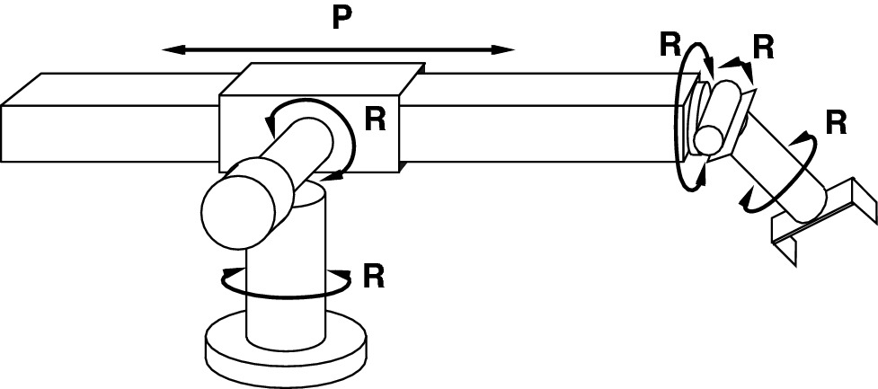
Example: Robotic Assembly
States | Real-valued coordinates of robot joint angles; Parts of the object to be assembled
Actions | Continuous motions of robot joints
Goal test | Complete assembly of all parts of the object!
Path costs | Time to execute

Slide 11
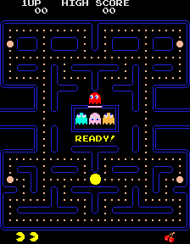
Example: Pac-Man
States | Position of Pac-Man, Boolean dots, ghost position
Actions | Left, right, up, down
Goal test | All dots are eaten
Path costs | 1 per eating a dot, dead after eaten by a ghost
Notes:
*discrete state game

Slide 12
Outline
Problem-Solving Agents
Searching for Solution

Slide 13
Solution
A solution is an action sequence.
So search algorithms work by considering various possible action sequences.
The possible action sequences starting at the initial state form a search tree:
the initial state is at the root;
the branches are actions;
the nodes correspond to states in the state space of the problem.

Slide 14
Example: Traveling in Romania

Slide 15
Example: Traveling in Romania

Slide 16
Tree Search Algorithms
Frontier: the set of all leaf nodes available for expansion at any given point.

Slide 17
Example: Traveling in Romania
Redundant!

Slide 18
Graph Search Algorithms
Use explored set to remember every expanded node to avoid redundant paths.
Notes:
*note: after any IF statement, there is an implicit “else” statement at the beginning of the next line.
*explore set = membership query (track if a node = state has been explored).

Slide 19
Example: Traveling in Romania

Slide 20
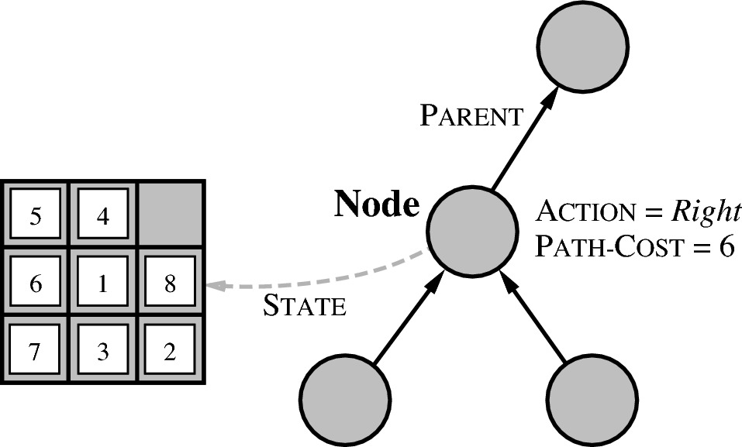
Implementation: Node
State | the state in the state space to which the node corresponds
Parent | the node in the search tree that generated this node
Action | the action that was applied to the parent to generate the node
Path-Cost | the cost of the path from the initial state to the node, as indicated by the parent pointers
Example: 8-Puzzle

Slide 21
Implementation: Frontier/Explored Sets
The frontier as a:
FIFO queue: it pops the oldest element;
LIFO stack: it pops the newest element;
Priority queue: it pops the highest-priority element according to some ordering function.
The explored set as a hash table.

Slide 22
Search Strategies
A strategy is defined by picking the order of node expansion.
Strategies are evaluated along the following dimensions:
Completeness: does it always find a solution if one exists?
Time complexity: number of nodes generated/expanded
Space complexity: maximum number of nodes in memory
Optimality: does it always find a least-cost solution?

Slide 23
Search Strategies (cont’d)
Time and space complexity are measured in terms of
b: maximum branching factor of the search tree
d: depth of the least-cost solution
m: maximum depth of the state space
Notes:
*b refers to breadth (number of children) of a given level as determined by max number of children nodes are able to contain.

Slide 24
Two Categories of Search
Uninformed search (or blind search):
The strategies have no idea about which successor is promisingly closer to the goal state.
All they can do is to generate successors and distinguish a goal state from a non-goal state.
Informed search (or heuristic search):
The strategies have some idea about which successor is promisingly/heuristically closer to the goal state.

Slide 25
Outline
Problem-Solving Agents
Searching for Solution
Uninformed Search

Slide 26
Uninformed Search Algorithms
Uninformed search strategies can be further distinguished by the order in which nodes in the frontier are expanded.
Breadth-First Search
Uniform-Cost Search
Depth-First Search
Notes:
General theme in the class:
A goal we have in mind.
A mathematical abstraction to formalize this
Algorithms that operate on these abstractions

Slide 27
Breadth-First Search (BFS)
Strategy: Expand a shallowest node first
Implementation: Frontier is a FIFO queue
Notes:
Shallowest nodes = breadth = a level: all unexpanded child nodes on the lowest level (closest to root).

Slide 28
Example: BFS on Traveling in Romania
Notes:
*even if we hit goal, we keep checking because there could be a shorter path; so we keep searching (if desired) until frontier set is empty.

Slide 29
Example: BFS on a Windy Maze (South Wind)
Step cost:
Moving westward: 2
Moving northward: 1
Moving eastward: 2
Moving southward: 3
f
20
23
25
27
29
28
e
16
26
d
11
6
2
8
24
c
5
1
0
3
21
b
12
7
4
9
14
18
a
17
13
10
15
19
22
1
2
3
4
5
6
Label inside each circle is the order of choosing this square and adding it into the frontier.

Slide 30
Example: BFS on 8-Puzzle
http://tristanpenman.com/demos/n-puzzle

Slide 31
BFS Properties
b
1 node
…
b nodes
b² nodes
b^{d} nodes
Complete | Yes (if b is finite)
Time | 1 + b + b² + b³ + : : : + b^{d} + b(b^{d}-1) = O(b^{d+1})
Space | O(b^{d-1}) for the explored set; O(b^{d}) for the frontier set Problem: it can easily generate nodes at 100MB/sec, so 24hrs = 8640GB.
Optimal | Yes (if cost = 1 per step) Not optimal in general
Notes:
*BFS is a brute force approach

Slide 32
Uniform Cost Search (UCS)
It is also called Dijkstra’s algorithm by theoretical computer scientists.
Strategy: expand a least-cost unexpanded node first.
Path-cost function: g(n)
Implementation: Frontier is a priority queue
Priority: path cost g(n)
Notes:
Can always find optimal solution.

Slide 33
Example: UCS on Traveling in Romania
146
291
75
140
239
118
220
229
317
317
450
418
392
366
455
512
Notes:
Note again: we keep expanding and even if a child node is the solution, we don’t know it is a solution yet until we actually expand it; so we continue to expand nodes with lowest current net cost along the different paths.

Slide 34
Example: UCS on a Windy Maze (South Wind)
f
17₇
21₉
24₁₁
26₁₃
29₁₅
28₁₃
e
16₆
27₁₂
d
11₅
5₃
2₁
6₃
25₁₁
c
7₄
1₂
0
3₂
22₁₀
b
12₇
8₅
4₃
9₅
14₇
19₉
a
18₁₀
13₈
10₆
15₈
20₁₀
23₁₂
1
2
3
4
5
6
Subscript is the path-cost by far, which decides the priority.
Notes:
Guaranteed shortest path.

Slide 35
UCS Properties
b
c ≤ 1
…
C*/ε “tiers”
c ≤ 2
c ≤ 3
ε: the low bound of step cost
C*: the cost of the optimal solution
Complete | Yes
Time | O(b^{C*/ε})
Space | O(b^{C*/ε})
Optimal | Yes, nodes expanded in increasing order of g(n).
Notes:
*another plus is that you can use UCS=Dijkstra algorithm to find the shortest path to all nodes in a tree.
*but downside is you have to explore more nodes than is desired; there is a more optimal way to do this (A* search).

Slide 36
UCS Issues
Remember: UCS explores increasing cost contours
The good: UCS is complete and optimal!
The bad:
Explores options in every “direction”
No information about goal location
We’ll fix that soon!
…
c ≤ 1
c ≤ 2
c ≤ 3
Start
Goal

Slide 37
Depth-First Search (DFS)
Strategy: Expand a deepest node first
Implementation: Frontier is a LIFO stack

Slide 38
Example: DFS on Traveling in Romania

Slide 39
Quiz: DFS on a Windy Maze (South Wind)
f
17
e
16
d
2
15
c
1
0
3
14
b
5
4
6
11
13
a
8
7
9
10
12
1
2
3
4
5
6
Notes:
Run 4 examples

Slide 40
Example: DFS on 8-Puzzle
http://tristanpenman.com/demos/n-puzzle

Slide 41
DFS Properties
Complete | Yes: complete in finite spaces with graph-search No: infinite-depth spaces with tree-search
Time | O(b^{m}): terrible if m is much larger than d but much faster than BFS if solutions are dense
Space | Exponential with graph-search O(bm) with tree-search, i.e., linear space!
Optimal | No
Notes:
*Does not require as much memory as BFS, but is more time intensive (time-space tradeoff)..
*b=max child nodes any node can have (node with the most children)
*m=max depth of a search tree
*d=depth of optimal solution
*”solutions are dense” refers solutions not being spread out across the same or different levels: they are relatively in the same location as you move down the tree.

Slide 42
Depth-Limited Search
DFS with depth limit l, i.e., nodes at depth l have no successors

Slide 43
Iterative Deepening Search (IDS)
Idea: get DFS’s space advantage with BFS’s time/shallow-solution advantages
Run a DFS with depth limit 1. If no solution…
Run a DFS with depth limit 2. If no solution…
Run a DFS with depth limit 3. …..
Isn’t that wastefully redundant?
Generally most work happens in the lowest level searched, so not so bad!
b
…
Notes:
*IDS = a compromise between DFS and BFS

Slide 44
Example: IDS on 8-Puzzle
http://tristanpenman.com/demos/n-puzzle

Slide 45
Outline
Problem-Solving Agents
Searching for Solution
Uninformed Search
Informed Search

Slide 46
Two Categories of Search
Uninformed search (or blind search):
The strategies have no idea about which successor is promisingly closer to the goal state.
All they can do is to generate successors and distinguish a goal state from a non-goal state.
Informed search (or heuristic search):
The strategies have some idea about which successor is promisingly/heuristically closer to the goal state.
Notes:
Heuristic: some defined measurement that estimates the distance of a state from the goal state.

Slide 47
Informed Search
The general approach we consider is called best-first search.
The expansion of a node n is based on an evaluation function f(n), which includes a heuristic function component h(n).
h(n) is the estimated cost of the cheapest path from the state at node n to a goal state.

Slide 48
Outline
Problem-Solving Agents
Searching for Solution
Uninformed Search
Informed Search
Greedy Best-First Search (GBFS)

Slide 49
Greedy Best-First Search (GBFS)
f(n) = h(n).
For example in route-finding problems, we use the straight-line distance as h(n)

Slide 50
Example: GBFS on Travelling in Romania
in km
176
100
Notes:
The straight-line distance chart given is the heuristic being used.

Slide 51
Example: GBFS on a Windy Maze (South Wind)
f
16₀
e
15₁
d
7₁₀
2₈
5₆
14₂
c
1₁₁
0
3₇
12₃
b
4₁₀
6₈
8₆
10₄
a
9₉
11₇
13₅
1
2
3
4
5
6
Subscript is the f=h value.
h(n) = Manhattan distance
Notes:
Run 4 examples
Side wind = cost of 2
Into south wind = cost of 3
Along/with south wind = cost of 1
Implement frontier as a min-heap priority queue (lowest h-value node expanded first).
FIFO to break tie of h-value (for example, add nodes as WNES, thus if two nodes have tied h values, then select in WNES order of nodes added to frontier)
IMPORTANT: This means I need to implement priority queue to switch positions (bubble down) the binary tree (heap) with nodes that it is tied with.
At least reduces search time on average; but does not guarantee optimal solution.

Slide 52
Example: GBFS on 8-Puzzle
http://tristanpenman.com/demos/n-puzzle
Notes:
Heuristic value using Manhattan distance for the 8-puzzle problem = sum of [all x+y movements each piece needs to move to go to its goal location].
If all tiles match their goal location: heuristic value = 0.
For our case, we do not consider the blank tile as having any heuristic value contributing to the total heuristic value for a state (although we could make it a part of the heuristic measurement if we wanted to).

Slide 53
GBFS Properties
Complete | No: can get stuck in loops with tree-search Yes: in finite space with graph-search.
Time | O(b^{m}), but a good heuristic can give dramatic improvement
Space | O(b^{m}), keeps all nodes in memory
Optimal | No
Notes:
*b=max child nodes any node can have (node with the most children)
*m=max depth of a search tree
*d=depth of optimal solution

Slide 54
Outline
Problem-Solving Agents
Searching for Solution
Uninformed Search
Informed Search
Greedy Best-First Search (GBFS)
A* Search

Slide 55
A* Search
Idea: avoid expanding paths that are already expensive
Evaluation function: f(n) = g(n) + h(n)
g(n) = cost so far to reach n
h(n) = estimated cost to goal from n
f(n) = estimated total cost of path through n to goal
Notes:
A* = UCS + GBFS = considers path cost so far AND heuristic (evaluation function) of all states during search.

Slide 56
Combining UCS and Greedy Search
Uniform-cost orders by path cost, or backward cost g(n)
Greedy orders by goal proximity, or forward cost h(n)
A* Search orders by the sum: f(n) = g(n) + h(n)

Slide 57
UCS vs A* Contours
Uniform-cost expands equally in all “directions”
A* expands mainly toward the goal, but does hedge its bets to ensure optimality
Start
Goal
Start
Goal

Slide 58
Admissible Heuristics h()
A* search uses an admissible heuristic h()
h(n) ≤ h*(n), where h*(n) is the true cost from n.
Also require h(n)≥0, so h(G) = 0 for any goal G.
h(n) never overestimates the actual road distance
Coming up with admissible heuristics is most of what’s involved in using A* in practice.
Notes:
h(n) should never evaluate to be more than the true cost from n → h(n) never (practically speaking, although some heuristics we develop we cannot always guarantee this 100% of the time) overestimates the actual road distance.

Slide 59
Example: Travelling in Romania
h(n) = Euclidean distance.
176
253
100

Slide 60
Example: 8-Puzzle
h₁(n) = total Manhattan distance.
h₂(n) = # of misplaced tiles.
h₁(S) = 4+0+3+3+1+0+2+1 = 14
h₂(S) = 6

Slide 61
Example: A* Search on Travelling in Romania
291+380=671
in km
75+374=449
140+253=393
239+176=415
176
220+193=413
118+329=447
317+100=417
450
100
418
366+160=526
417+138=555
Notes:
NOTE At goal: f(n) = g(n) + h(n) → h(n) = 0 when at goal; thus f(n) at goal evaluates essentially to g(n) = path cost.

Slide 62
Example: A* Search on a Windy Maze (South Wind)
f
20₁₃₊₀
e
19₁₂₊₁
d
11₅₊₁₂
5₃₊₁₀
2₁₊₈
6₃₊₆
18₁₁₊₂
c
8₄₊₁₃
1₂₊₁₁
0
3₂₊₇
16₁₀₊₃
b
9₅₊₁₂
4₃₊₁₀
7₅₊₈
12₇₊₆
14₉₊₄
a
10₆₊₁₁
13₈₊₉
15₁₀₊₇
17₁₂₊₅
1
2
3
4
5
6
Subscript is the f=g+h value.
Notes:
Run 4 examples
May take longer time to search than GBFS, but we will always find optimal path with A*.

Slide 63
Example: A* Search on 8-Puzzle
http://tristanpenman.com/demos/n-puzzle

Slide 64
A* Properties
Complete | Yes, unless there are infinitely many nodes with f ≤ f(G), where G is the goal.
Time | Exponential in [relative error in h x length of solution.]
Space | Keeps all nodes in memory
Optimal | Yes, cannot expand f_{i+1} until f_{i} is finished
Notes:
Still exponential in time like UCS in worst case, but does better on average at narrowing down the search in general.
However, UCS algorithm = Dijstrka = can find best path to all nodes along (as it searches) the search → but this is why in general the time cost is more than A*.

Slide 65
A* Applications
Video games
Pathing / routing problems
Resource planning problems
Robot motion planning
Language analysis
Machine translation
Speech recognition
…

Slide 66
Problem of Problem-Solving Agents
It works when
Full observable
Discrete
Deterministic
Static

